Slide 1
Outlier Detection
Lindsey Curtis & Scott Onestak

Slide 2


Why is Outlier Detection Important?
Identity Theft Detection
Medical Testing
Understanding Data
Weather Prediction
Improved Data Modeling
Customized Marketing

Slide 3
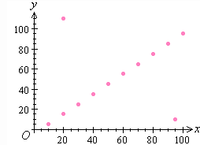
What is an Outlier?
“ Something unusual or unexpected ”
~Mirriam-Webster
Types
Global Outliers
Contextual Outliers
Collective Outliers

Slide 4
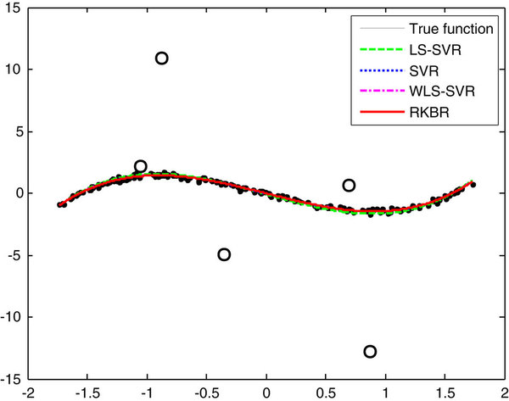
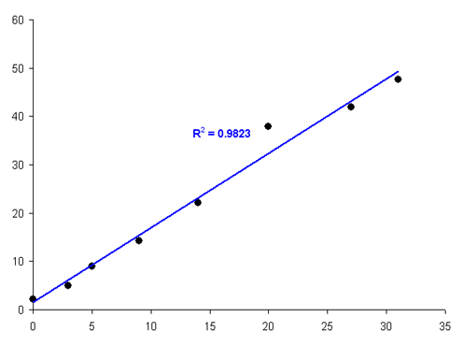
Global Outliers
Observations deviating significantly from dataset

Slide 5
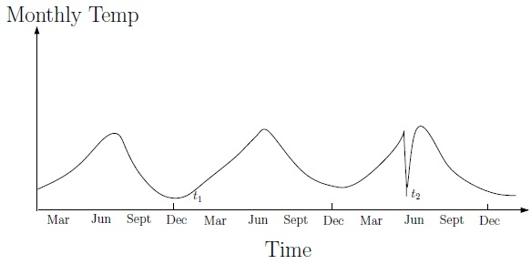
Contextual Outliers
An anomaly based on examination against subset of contextual attributes

Slide 6
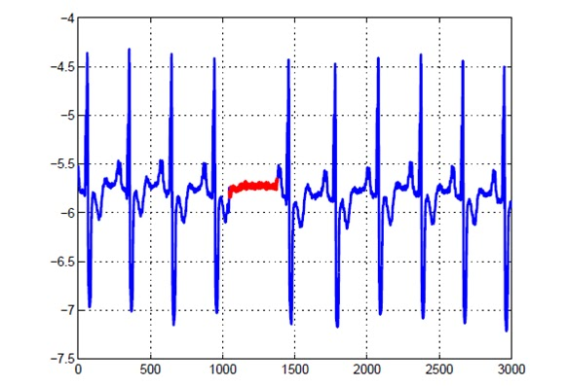
Collective Outliers
objects as a whole deviate significantly from dataset

Slide 7
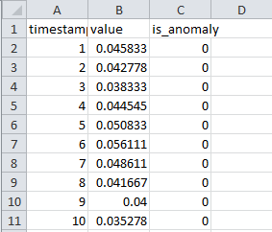
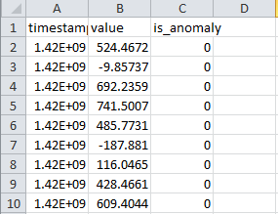
Data Acquisition
Yahoo!’s Labeled Anomaly Detection data set that includes real and synthetic Yahoo! production traffic
real synthetic
A1 Benchmark
A2 Benchmark
A3 Benchmark
A4 Benchmark

Slide 8
Methodology
Regression Analysis
Partition-Based Clustering
Analyze algorithms from different areas of outlier detection
Moving Window Methodology
Autoregressive Modeling

Slide 9
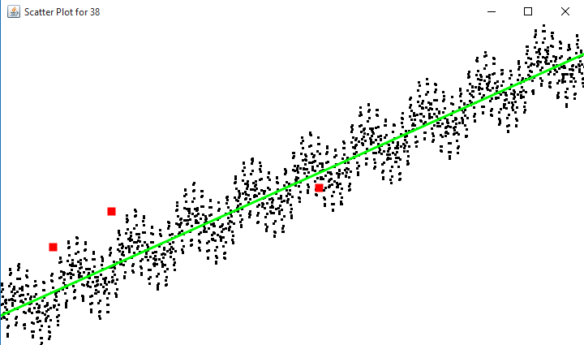
Linear Regression
Values regressed onto timestamps
Distance between model prediction and actuality of data point measured
Outliers detected based on standard deviations from average residual differences
true positives=purple, true negatives=black
false positives=orange, false negatives=red .

Slide 10
Linear Regression
Advantages
Disadvantages
Simplicity in implementation and design
Efficient runtime
Effective at locating global outliers
Data may not be linearly related
Assumes variability is consistent throughout data

Slide 11
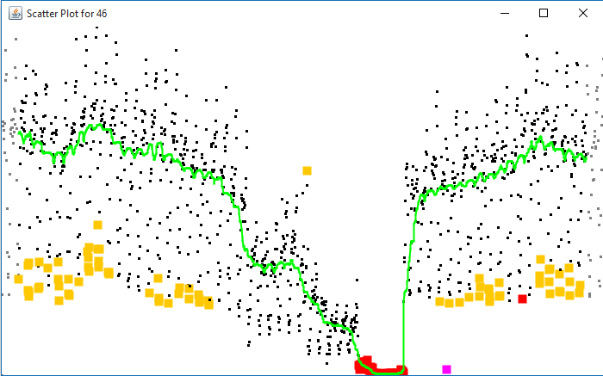
OutlierMAD
Median Average Deviation
Uses moving window by finding median within specified range
Data that falls outside of average in that range are classified as outliers
true positives=purple, true negatives=black
false positives=orange, false negatives=red .

Slide 12
OutlierMAD
Advantages
Disadvantages
Measurements will be robust to outliers
Allows estimate for each data point to move up and down dependent data
→ No assumption of shape to fit entire model
Collective outliers undetected due to being in range
Tendency to overfit data
Need for future data points could make detection ineffective in real world examples

Slide 13
Median Average Approach
Goal: improve MAD by not requiring points on both sides of the element
Results
Pro’s
Effective at preventing overfitting data and detecting more outliers compared to previous algorithm
Con’s
Still ineffective at detecting collective outliers
Weighted all points the same, when points closest to data should be given higher priority

Slide 14
Mean Average Approach
Means-based implementation to improve upon being reflective of weights of data points closest to element
Challenges:
Means is overly sensitive to outliers
→ recalculation upon outlier detection
Results are subjective to size of range being used
Improvements:
Increased effectiveness in detecting outliers
Ability to be applied in detecting collections of outliers

Slide 15
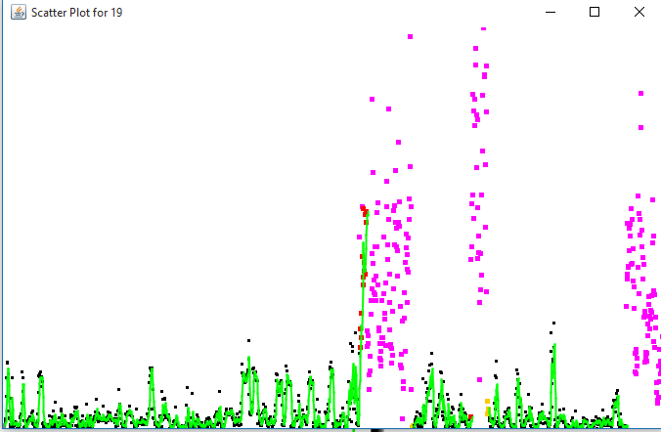
Mean Average Approach
true positives=purple, true negatives=black
false positives=orange, false negatives=red .

Slide 16
Autoregression Approach
Theory: Previous values are effective predictors of future data
More freedom in predicting values yields more effective prediction compared to mean average approach
Since only the previous value is used, AR would not be robust to a collection of outliers

Slide 17
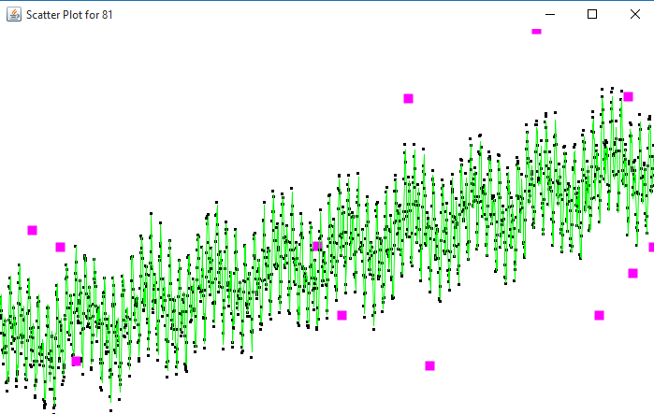
Autoregression Approach
true positives=purple, true negatives=black
false positives=orange, false negatives=red .

Slide 18
K-Means Approach
Aim: use clustering to allow for use of mean for application in testing for global outliers without outliers severely skewing data
Effective in testing for global outliers
Clustering supportive for multi-dimensional data applications
Threshold variables allow algorithm to be modified to fit data
Ineffective in testing collective outliers
Little improvement on other methods for one-dimensional data

Slide 19
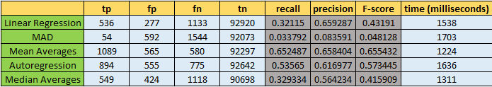
Results
A1 Benchmark Dataset
Mean average worked best at detecting outliers
More robust, detects larger groupings of outliers

Slide 20
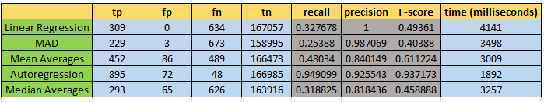
Results
A3Benchmark Dataset
Very few collections of outliers, which AR would be unable to detect
Autoregression outperformed significantly
Ability to detect contextual outliers contributed to performance classification

Slide 21
Conclusion
Autoregression = most robust
Discovery of a single fail-proof outlier detection method for all cases
ability to detect contextual outliers
(Unfortunately not…)
However...
Mean Averages: effective outlier detection
more robust to collective outliers
OutlierMAD= worst performance overall
Linear Regression
Median Averages
K-means= ability to expand dimensions
for this analysis, not effective
Relatively similar in benefit

Slide 22
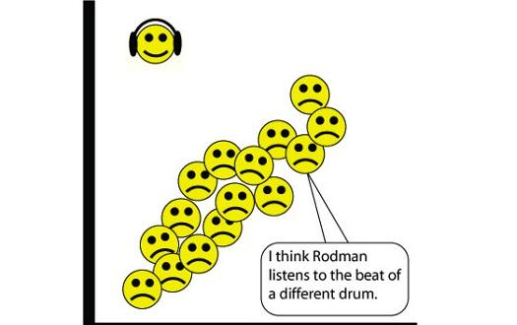
Conclusion
In short, analysis of various outlier detection methods has highlighted various types of outliers and how different methods may detect them. Certain algorithms perform functions more effectively than others, and an understanding of the benefits and costs of each can provide the opportunity to employ them in the most effective environment.

